Slide 1
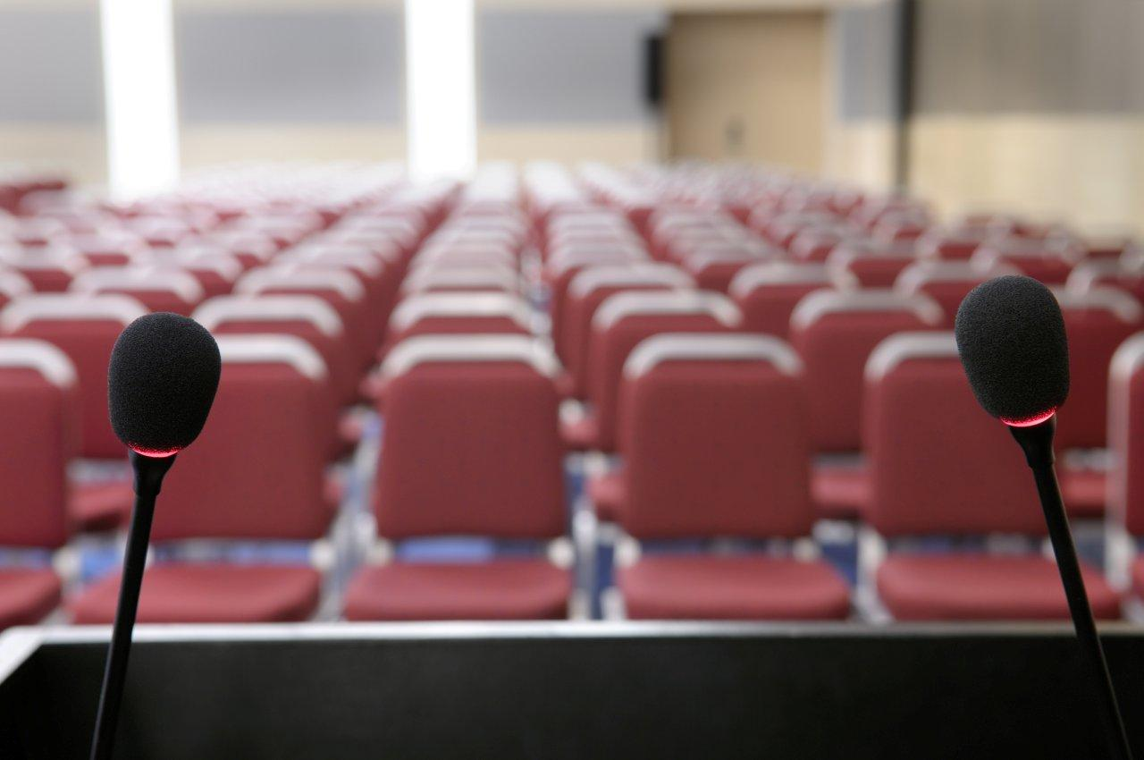
Mic Anywhere: An instance microphone from your mobile
Chathuranga d.m.s. (e/13/043)
Gajanayake h.u.p.(e/13/106)
Sandeepa a.m.h. (e/13/319))

Slide 2
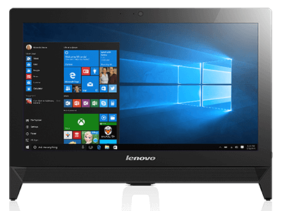
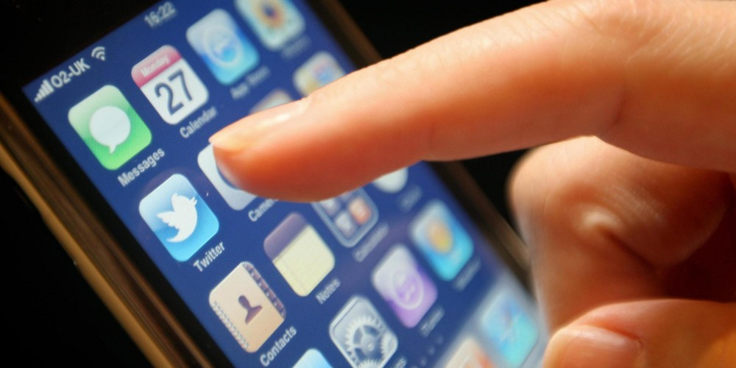
requirements
Android application developing
Desktop application developing
Sound transferring
Wifi routing
Traffic management
Sound tuning

Slide 3
Expected outcomes
An android application to broadcast an individuals opinion within the audience.
A desktop application which can be used by the presenter to allow the audience to talk.
Proper routing from the audience to the presenters desktop and then to the speakers.
Managing to give the first requested to first express his/her idea.

Slide 4
demonstration
1.mobile application

Slide 5
2.desktop application

Slide 6
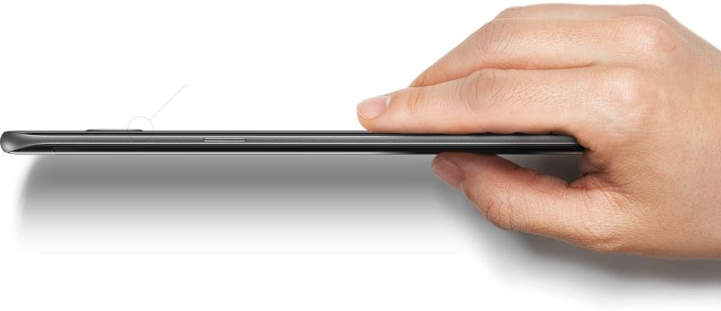
Thank you !

